Slide 1
Chapter 1 Introduction to Simulation and Modeling
October 2019

Slide 2
Pre-Requisites
Probability
MS-Excel
Programming skills

Slide 3
Textbook
Author: Averill M. Law
Title: “Simulation Modeling and Analysis”, Fourth Edition
Publisher: McGraw-Hill Higher Education
Year: 2007
Notes:
The codes in this book are written in C++. However, simulations throughout the course will be done using Excel. Ideas from this book will be used
-

Slide 4
Course Outline
Introduction to simulation
Simulation examples in Excel spreadsheets
General principles of simulation
Statistical models in simulation
Queuing models
Random number generation
Random variate generation
Monte-Carlo simulation

Slide 5
Lecture (1) Introduction to Systems and Simulation

Slide 6
Introduction to Simulation
Simulation is the imitation of a real-world process or system over time [Banks et al.]
It is used for analysis and study of complex systems
Simulation requires the development of a simulation model and then conducting computer-based experiments with the model to describe, explain, and predict the behaviour of the real system

Slide 7
What is Simulation
The SIMULATION is the process of designing a mathematical or logical model of the real system and then conducting computer-based experiments with the model to describe, explain, and predict the behavior of the real system.

Slide 8
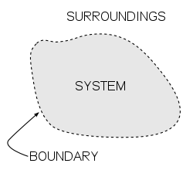
System Environment
A system is affected by changes that occur outside its boundaries. Such changes are said to occur in the system environment
The boundary between the system and its environment depend on the purpose of the study
Example: Bank System
There is a limit on the maximum interest rate that can be paid
For a study of a single bank, this would be an example of a constraint imposed by the environment
For a study of the effect of monetary laws on the banking industry.

Slide 9
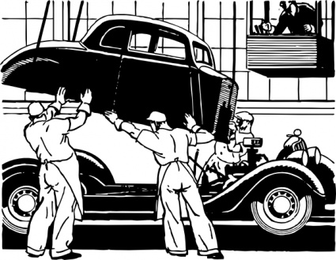
Systems
Systems: a group of objects joined together in some regular interaction or interdependence towards the accomplishment of some purpose
Example: A production system manufacturing automobiles. Machines, components and workers operate jointly to produce vehicles

Slide 10
System Components
Object of interest in the system
Entity
object
Attribute
State
Activity
Event
An instantaneous occurrence that may change the state of the system
Property of an entity
System
An action that takes place over a period of specified length and changes the state of the system
The collection of variables necessary to describe the system at a particular time, relative to the objectives of the study [Law]

Slide 11
System Components
Exogenous:
Activities and events occurring outside the system
Endogenous:
Activities and events occurring within a system

Slide 12
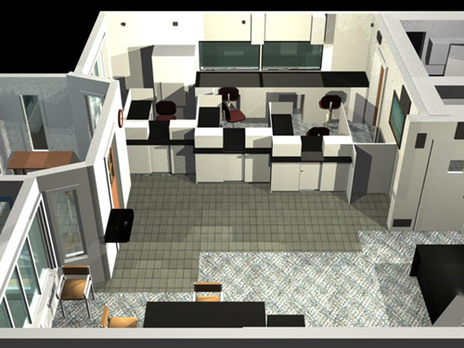









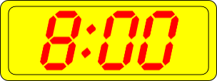
Example
State Variables:
# busy tellers, # customers waiting in line or being served, arrival time of next customer
Attribute:
Balance in the customers’ accounts
Object: Customers
Activity:
Making deposits
Events:
Arrival, departure

Slide 13
Examples
System | Entities | Attributes | Activities | Events | State Variables
Railway | Passengers | Origin, destination | Traveling | Arrival at station, arrival at destination | Number of passengers waiting at each station
Production | Machines | Speed, capacity, breakdown rate | Welding, stamping | Breakdown | Status of machines (busy, idle, shutdown)
Communications | Messages | Length, destination | Transmitting | Arrival at destination | Number of packets waiting to be transmitted
Inventory | Warehouse | Capacity | Withdrawal | Demand | Level of inventory

Slide 14
Models
A model is a representation of a system for the purpose of studying that system
It is only necessary to consider those aspects of the system that affect the problem under investigation
The model is a simplified representation of the system
The model should be sufficiently detailed to permit valid conclusions to be drawn about the actual system
Different models of the same system may be required as the purpose of the investigation changes

Slide 15
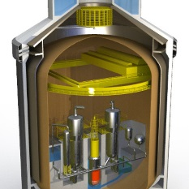
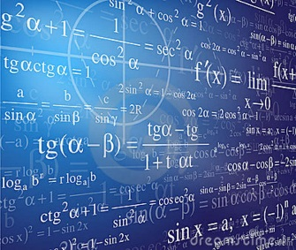
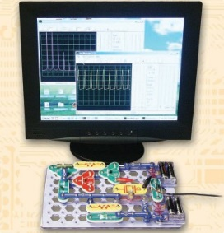
Ways to Study a System [Law]
System
Experiment with a Model of the System
Mathematical Model
Physical Model
Analytical Solution
Simulation

Slide 16
Why are Models Used?
It is not possible to experiment with the actual system, e.g.: the experiment is destructive
The system might not exist, i.e. the system is in the design stage
Example: Bank
Reducing the number of tellers to study the effect on the length of waiting lines may annoy the customers such that they will move their accounts to a competitor

Slide 17
Types of Models
A Mathematical Model utilizes symbolic notations and equations to represent a system
Example: current and voltage equations are mathematical models of an electric circuit
A Physical Model is a larger or smaller version of an object
Example: enlargement of an atom or a scaled version of the solar system

Slide 18
Classifications of Simulation Models
Static
Dynamic
Deterministic
Stochastic
Discrete
Continuous

Slide 19
Static and Dynamic Models
Static
i.e. Monte Carlo Simulation – Represents a system at a particular point in time
Example: Simulation of a coin toss game
Dynamic
Represents systems as they change over time
Example: The simulation of a bank from 9:00am – 4:00pm

Slide 20
Deterministic and Stochastic Models
Deterministic
Contain no random variables
Stochastic
Has one or more random variables
Example: random arrivals at a bank. Output may be average number of waiting customers, average waiting time. This output is only a statistical estimate of the system
Example: Patients arriving at the dentist’s office exactly at their scheduled appointments
Has a known set of inputs that will result in a unique set of outputs. It is possible to predict what will happen.
Random inputs lead to random outputs. The behaviour of a model cannot be entirely predicted.
Random outputs →only estimates of the true characteristics of the system

Slide 21
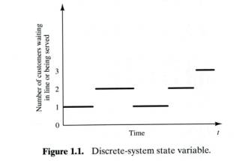
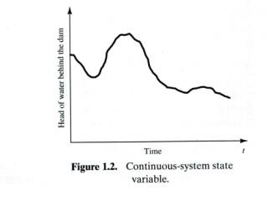
Discrete Vs Continuous
Discrete
Continuous
State variables change instantaneously at separated points in time
Example: Bank
Number of customers changes only when customer arrives or departs
State variables change constantly with respect to time
Example: Airplane flight
Position and velocity are constantly changing with respect to time

Slide 22
Discrete and Continuous Models
Continuous
Continuous model: the state variables change in a continuous way, and not abruptly (فجائي (from one state to another (infinite number of states).
Discrete
Discrete model: the state variables change only at a countable number of points in time. These points in time are the ones at which the event occurs/change in state.
The choice of whether to use a discrete or continuous model depends on the characteristics of the system and the objectives of the study

Slide 23
When is Simulation Appropriate
Simulation enables the study of, and interaction with, the internal actions of a real system
The effects of changes in state variables on the model’s behaviour can be observed
The knowledge gained from the simulation model can be used to improve the design of the real system under investigation

Slide 24
When is Simulation Appropriate
Changing inputs and observing outputs can produce valuable insights (رؤى)about the importance of variables and how they interact
Simulations can be used to experiment with different designs and policies before implementation so as to prepare for what might happen
Simulations can be used to verify analytic solutions

Slide 25
Advantages of Simulation
Effects of variations in the system parameters can be observed without affecting the real system
New system designs can be tested without resources acquisition
Hypotheses on how or why certain phenomena occur can be tested for feasibility
Time can be expanded or compressed to allow for speed up or slow down of the phenomenon under investigation
conclusions can be obtained about the interactions of variables and their importance
Bottleneck analysis can be performed in order to discover where work processes are being delayed excessively(مفرط)

Slide 26
When is Simulation not Appropriate
The problem can be solved by common sense
The problem can be solved analytically
It is less expensive to perform direct experiments
Costs of modeling and simulation exceed savings
Resources or time are not available
Lack of necessary data
System is very complex or cannot be defined

Slide 27
Disadvantages of Simulation
Model building requires special training
Simulation results are often difficult to interpret. Most simulation outputs are random variables - based on random inputs – so it can be hard to distinguish whether an observation is the result of system inter-relationship or randomness
Simulation modeling and analysis can be time consuming and expensive

Slide 28
Simulation Packages
Utilize simulation packages that only need input for their operation, e.g.: SIMULINK, MS-Excel
Many simulation packages have output analysis capabilities, e.g. MATLAB, Excel
Simulation has become faster due to advances in hardware

Slide 29
Steps in a Simulation Study
Phase I
Problem formulation: statement of the problem
Setting of objectives and overall design: questions to be answered by the simulation
Phase III
Experimental design: which alternatives (designs) to simulate
Production runs and analysis: to estimate measures of performance for the system designs that have been simulated. Measures of performance may depend on statistical analysis, e.g.: average, probability, frequency, etc.
Phase IV
Documentation
Implementation
Phase II
Model conceptualization: abstract the essential features of the problem, select and modify basic assumptions that characterize the system, start with a simple model, describe the model
Data collection: start early because it may take a lot of time
Model translation: programming
Verification: is the computer program functioning properly
Validation: does the model accurately represent the system
More runs? a sufficient number is needed to guarantee statistical accuracy

Slide 30
1
Problem Formulation
2
Setting of Objectives and Overall Project Plan
3
4
Model Conceptualization
Data Collection
5
Model Translation
No
6
Verified
Yes
No
7
No
Validated
8
Yes
Experimental Design
9
Production Runs and Analysis
Implementation
11
Documentation and Reporting
12
Yes
10
No
More Runs

